Slide 1
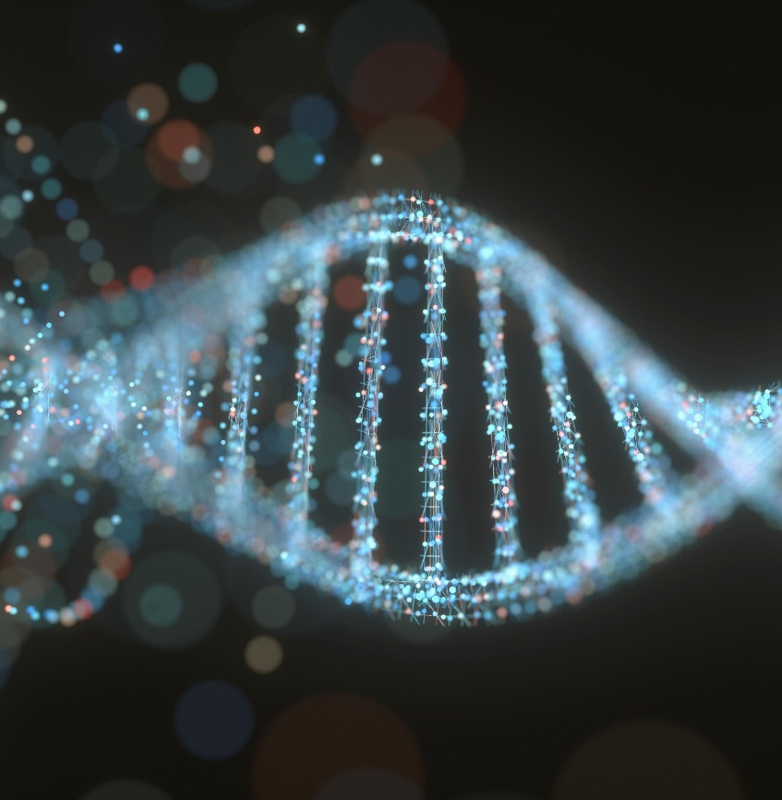

SCI225 · PATHOPHYSIOLOGY
Week Eleven
The Renal & Urinary System
Dr. Vidya Aggrawal Nightingale College
// week 11 visual
Notes:
Welcome to Week 11 — the Renal and Urinary System. How the kidney filters, concentrates, and regulates, then what goes wrong: obstruction, infection, AKI, CKD, and the pediatric renal disorders.

Slide 2

TODAY'S SESSION
Agenda
01
Structure & function — nephron, GFR, RAAS
02
Alterations — stones, UTI, AKI, CKD
03
Pediatric renal & urinary
04
Knowledge checks & discussion
SCI225 · WEEK 11
02 / 28
Notes:
Today's agenda — three sections.

Slide 3
WEEK ELEVEN
Learning objectives
1
Recall the structure and function of the renal and urinary system.
2
Describe the alterations of renal and urinary function and their consequences.
3
Discuss pediatric renal and urinary disorders and their clinical presentations.
SCI225 · WEEK 11
03 / 28
Notes:
Three weekly learning objectives.

Slide 4
Weekly resources
Required reading
Clinical tools
Renal & urinary structure & function chapter
Alterations of renal & urinary function chapter
Week 11 Study Guide — covers all objectives
Creatinine & GFR interpretation
Cystitis vs. pyelonephritis quick reference
Renal cheat sheet — highest-yield patterns
Supplemental
Nephron & RAAS diagram refresher
AKI prerenal/intrarenal/postrenal overview
SCI225 · WEEK 11
04 / 28
Notes:
Required reading and resources.

Slide 5

MODULE ELEVEN
11
Week Eleven
The renal & urinary system — the nephron and GFR, the hormones that control blood pressure, then obstruction, infection, AKI, CKD, and the pediatric renal disorders.
SCI225 · WEEK 11
05 / 28
Notes:
Open Module 11 — Week Eleven.

Slide 6
ACTION ITEMS
What is due this week?
Week 11 Pre-Assessment — complete before the webinar.
Discussion — apply renal pathophysiology to a clinical scenario; initial post + 2 peer replies.
Webinar Quiz — covers the nephron/GFR, stones, UTI, AKI, CKD, and pediatric renal disease.
Case Study — apply renal mechanisms to a patient presentation.
Webinar — kidney stones, AKI, CKD, and pediatric renal disorders. Bring your reading notes.
SCI225 · WEEK 11
06 / 28
Notes:
What is due this week.

Slide 7
SECTION · STRUCTURE & FUNCTION
Section objective
1
Recall how the nephron filters and concentrates, how GFR is measured, and how the kidney defends its filtration rate and controls blood pressure.
SCI225 · WEEK 11
07 / 28
Notes:
Section 1 objective — structure and function.

Slide 8
The nephron, filtration & GFR
The nephron is the kidney's functional unit — filter at the glomerulus, fine-tune along the tubule
Structure
Job
Glomerulus
Filters blood — driven by capillary hydrostatic (blood) pressure pushing fluid into the filtrate
Proximal tubule
Reabsorbs the most — water, sodium, glucose, nutrients (the bulk-reabsorption workhorse)
Loop of Henle
Countercurrent system builds the medullary gradient → lets the kidney concentrate urine
Distal tubule / collecting duct
Final adjustments under aldosterone (Na/K) and ADH (water)
Key idea: filtration is driven by blood (hydrostatic) pressure; the proximal tubule reabsorbs the most; the loop of Henle is what lets you make concentrated urine.
SCI225 · WEEK 11
08 / 28
Notes:
The nephron, filtration, and GFR.

Slide 9
THE FUNCTION MARKER
Creatinine is the mirror of GFR
GFR (glomerular filtration rate): how much blood the kidneys filter per minute — the key measure of kidney function.
Creatinine is a waste product cleared by filtration.
When GFR falls, creatinine rises — it accumulates in the blood.
So a high plasma creatinine = reduced kidney filtration.
Pearl: watch creatinine as the inverse of GFR — it goes up when filtration goes down.
SCI225 · WEEK 11
09 / 28
Notes:
Creatinine is the mirror of GFR.

Slide 10
Hormonal control & autoregulation
Mechanism
What it does
Autoregulation
Adjusts the afferent (incoming) and efferent (outgoing) arterioles to hold GFR steady despite changing BP
Sympathetic activation
Constricts the afferent arteriole → less blood in → ↓ GFR (shunts blood away in shock)
RAAS
Low BP/flow → renin → angiotensin II (vasoconstriction) + aldosterone (Na/water retention) → ↑ BP
ADH
Makes the collecting duct reabsorb water → concentrated urine, higher blood volume
Key idea: low BP → renin → RAAS → retain salt & water → BP up. Strong sympathetic drive constricts the afferent arteriole and drops GFR.
SCI225 · WEEK 11
10 / 28
Notes:
Hormonal control and autoregulation — RAAS, ADH, the arterioles.

Slide 11
KNOWLEDGE CHECK
Question 1
Which factor drives glomerular filtration?
A
Capillary hydrostatic (blood) pressure pushing fluid into the filtrate
B
Plasma oncotic pressure pulling fluid in
C
Tubular reabsorption
D
ADH secretion
SCI225 · WEEK 11
11 / 28
Notes:
Knowledge check — what drives filtration.

Slide 12
KNOWLEDGE CHECK
Question 2
A patient's blood pressure drops. Which mechanism explains increased renin release?
A
Reduced renal perfusion triggers renin to activate RAAS
B
High blood pressure stimulates renin
C
Excess sodium triggers renin
D
ADH suppresses renin
SCI225 · WEEK 11
12 / 28
Notes:
Knowledge check — renin release.

Slide 13
KNOWLEDGE CHECK
Question 3
Sympathetic activation decreases afferent arteriole diameter. What results?
A
Reduced blood flow into the glomerulus and a lower GFR
B
Increased GFR
C
Increased renal blood flow
D
No change in filtration
SCI225 · WEEK 11
13 / 28
Notes:
Knowledge check — sympathetic and GFR.

Slide 14
SECTION · ALTERATIONS
Section objective
2
Describe the alterations of renal and urinary function — obstruction and stones, urinary tract infection, acute kidney injury and glomerular disease, and chronic kidney disease.
SCI225 · WEEK 11
14 / 28
Notes:
Section 2 objective — alterations.

Slide 15
Obstruction & kidney stones
Concept
Mechanism
Hydronephrosis
Obstruction backs urine up → renal pelvis/calyces dilate under pressure
↓ GFR during obstruction
Back-pressure opposes filtration → GFR falls; prolonged obstruction → AKI
↑ Infection risk
Stagnant, retained urine is a breeding ground → more UTIs
Postobstructive diuresis
After relief, retained fluid & solutes are dumped → large urine output (watch for dehydration)
Kidney stones (calculi)
Concentrated urine + supersaturation → crystals; calcium oxalate is most common
Renal colic: a stone causes sudden severe flank pain radiating to the groin, in waves (colicky), with restlessness, nausea, and concentrated urine. Hydration helps prevent stones.
SCI225 · WEEK 11
15 / 28
Notes:
Obstruction and kidney stones.

Slide 16
Urinary tract infection — usually ascending
Cystitis (lower UTI)
Pyelonephritis (upper UTI)
Bladder infection/inflammation
Urgency, frequency, dysuria (burning)
Suprapubic discomfort
Inflamed wall signals the urge even when nearly empty
Infection reaches the kidney (usually ascending from the bladder)
Flank pain, fever, chills
Systemic illness
Key idea: UTIs ascend (urethra → bladder → up to kidney). Cystitis = bladder (urgency/frequency/burning); pyelonephritis = kidney (flank pain + fever). Stasis from obstruction or reflux raises risk.
SCI225 · WEEK 11
16 / 28
Notes:
Urinary tract infection — cystitis vs pyelonephritis.

Slide 17
Acute kidney injury & glomerular disease
Category
Mechanism
Prerenal AKI (most common)
Poor blood flow (dehydration, hemorrhage, shock) → ↓ GFR → oliguria
Intrarenal AKI
Direct kidney damage (toxins, ischemia, myoglobin)
Postrenal AKI
Obstruction backs pressure up the tract
Glomerulonephritis
Inflammation damages the glomerulus → blood leaks into urine (hematuria)
Nephrotic pattern
Barrier damage → massive protein loss (proteinuria) → low albumin → edema
Key idea: dehydration → prerenal AKI → oliguria + rising creatinine. Injured filter leaks: inflammation → blood (hematuria); barrier breakdown → protein (proteinuria) → edema.
SCI225 · WEEK 11
17 / 28
Notes:
Acute kidney injury and glomerular disease.

Slide 18
Chronic kidney disease
Progressive, irreversible loss of nephrons — failing excretion, balance, and hormone production
Consequence
Mechanism
Most common cause
Diabetes (then hypertension) damages the small renal vessels over years
Anemia (fatigue, pallor)
Damaged kidneys make less erythropoietin (EPO) → fewer RBCs
Hyperkalemia
Failing kidneys can't excrete potassium → it builds up (dangerous for the heart)
Fluid overload / acidosis / waste buildup
Lost excretory capacity → edema, metabolic acidosis, rising creatinine/BUN
Key idea: CKD's #1 cause is diabetes. Two classic links: low EPO → anemia; failure to excrete potassium → hyperkalemia.
SCI225 · WEEK 11
18 / 28
Notes:
Chronic kidney disease.

Slide 19
KNOWLEDGE CHECK
Question 4
What process causes hydronephrosis?
A
Obstruction backs urine up, dilating the renal pelvis and calyces under pressure
B
Increased GFR
C
Excess water intake
D
Loss of renal blood flow only
SCI225 · WEEK 11
19 / 28
Notes:
Knowledge check — hydronephrosis.

Slide 20
KNOWLEDGE CHECK
Question 5
A patient with severe dehydration develops oliguria. Which mechanism explains it?
A
Reduced renal blood flow lowers GFR, so less urine is formed (prerenal AKI)
B
Increased GFR
C
Excess ADH suppression
D
Glomerular protein loss
SCI225 · WEEK 11
20 / 28
Notes:
Knowledge check — prerenal AKI.

Slide 21
KNOWLEDGE CHECK
Question 6
Which electrolyte imbalance is a CKD patient at greatest risk for developing?
A
Hyperkalemia (high potassium)
B
Hypokalemia
C
Hypernatremia only
D
Hypocalcemia only
SCI225 · WEEK 11
21 / 28
Notes:
Knowledge check — CKD and potassium.

Slide 22
SECTION · PEDIATRIC RENAL & URINARY
Section objective
3
Discuss the congenital and obstructive problems, the childhood glomerular diseases, the renal tumor, and why infants are fluid-fragile.
SCI225 · WEEK 11
22 / 28
Notes:
Section 3 objective — pediatric renal.

Slide 23
Congenital & obstructive — reflux & PKD
Condition
Mechanism
Vesicoureteral reflux (VUR)
Failed valve where the ureter enters the bladder → urine flows backward toward the kidney → recurrent infections & scarring
UPJ obstruction
Narrowing where renal pelvis meets ureter → back-pressure → hydronephrosis
Bladder outlet obstruction
Posterior urethral valves block the outlet → back-pressure → hydronephrosis & kidney damage
Polycystic kidney disease (PKD)
Fluid-filled cysts enlarge and compress/replace functional tissue → progressive loss of function
Key idea: in VUR the one-way bladder-ureter valve fails, so urine refluxes up and carries bacteria → recurrent UTIs. PKD isn't a blockage — cysts squeeze out working nephrons.
SCI225 · WEEK 11
23 / 28
Notes:
Congenital and obstructive — reflux and PKD.

Slide 24
Pediatric glomerular disease & HUS
Condition
Mechanism
Poststreptococcal glomerulonephritis
Immune complexes form after strep, deposit in glomeruli → inflammation → hematuria, edema, hypertension (appears after the infection resolves)
Nephrotic syndrome (childhood)
Glomerular barrier damage → heavy proteinuria → low albumin → edema
Hemolytic uremic syndrome (HUS)
Often after Shiga-toxin E. coli → endothelial injury & microthrombi in the kidney → renal injury (with hemolytic anemia + low platelets)
Nephritic vs. nephrotic: inflammation lets blood through → hematuria (poststrep GN); barrier breakdown lets protein out → proteinuria → edema (nephrotic). HUS injures via microthrombi.
SCI225 · WEEK 11
24 / 28
Notes:
Pediatric glomerular disease and HUS.

Slide 25
TUMOR & FLUID RISK
Wilms tumor & infant fluid fragility
Nephroblastoma (Wilms tumor): malignant proliferation of embryonic kidney cells → a (often large, one-sided) abdominal/renal mass in young children — the classic childhood kidney cancer.
Untreated bladder outlet obstruction: persistent back-pressure → hydronephrosis → progressive kidney damage/failure.
Why infants are fluid-fragile: higher body-water percentage, faster turnover, and immature kidneys that concentrate urine poorly → they dehydrate quickly and tip into fluid/electrolyte imbalance.
SCI225 · WEEK 11
25 / 28
Notes:
Wilms tumor and infant fluid fragility.

Slide 26
KNOWLEDGE CHECK
Question 7
What explains recurrent infections with vesicoureteral reflux?
A
Urine refluxes backward toward the kidney, carrying bacteria upward
B
The kidney over-filters bacteria
C
Increased bladder emptying
D
Reduced bladder pressure
SCI225 · WEEK 11
26 / 28
Notes:
Knowledge check — vesicoureteral reflux.

Slide 27
KNOWLEDGE CHECK
Question 8
Which mechanism best explains nephroblastoma (Wilms tumor)?
A
Malignant proliferation of embryonic kidney cells forming a renal mass
B
Bacterial kidney infection
C
A blocking stone
D
Immune-complex deposition
SCI225 · WEEK 11
27 / 28
Notes:
Knowledge check — Wilms tumor.

Slide 28
“
Watch the GFR and follow the back-pressure. Creatinine rising means filtration falling; obstruction anywhere backs up into the kidney; and in children, a failed valve or an immature kidney changes everything. Name the mechanism and the labs explain themselves.
DR. VIDYA AGGRAWAL · PATHOPHYSIOLOGY COURSE INSTRUCTOR · NIGHTINGALE COLLEGE
SCI225 · WEEK 11
28 / 28
Notes:
Closing — watch the GFR, follow the back-pressure.

